Slide 1
Module 5 Architectures, Features, and Details of Data Integration Tools
Lesson 2: Common Features of Data Integration Tools
Notes:
Welcome to Lesson 2 of Module 5 on Architectures, Features, and Details of Data Integration Tools.
Opening question
Why is an integrated development environment an important feature for data integration tools?
Do all (or early) data integration tools provide an integrated development environment?

Slide 2
Lesson Objectives
Describe common features of data integration tools
List some common transformation processes supported by data integration tools
Notes:
Objectives:
Describe common features supported by data integration tools for graphical specification, job management, data profiling, and change data capture
List common transformations supported by data integration tools

Slide 3
Feature Overview
Essential
Integrated development environment
Workflow and component specifications
Secondary
Change data capture
Data profiling
Data source connectivity
Repository
Job management
Notes:
This diagram divides features of data integration tools into essential and secondary categories. Integrated development environments (IDEs) support complex software projects with a source code editor, visual specification tools, debugger, and code generator packaged in a convenient graphical interface. Since data integration involves complex software development, IDEs have become essential for data integration tools. Most data integration tools use rule and graphical specifications rather than procedural coding to indicate workflow and transformations. Some tools can generate code that can be customized for more flexibility. Data source connectivity components and repository are also essential features.
Secondary features are provided by most products, but sometimes require an extended product with an additional license. Job management involves monitoring and scheduling of workflows for execution of data integration workflows. Change data capture typically uses a “publish and subscribe” model to control change data availability and notify subscribers about change data availability. Data profiling help a data warehouse administrator assess quality levels in data sources.
Job management: run-time and performance issue
Change data capture: support for initial part of refresh
Data profiling: support for initial population

Slide 4
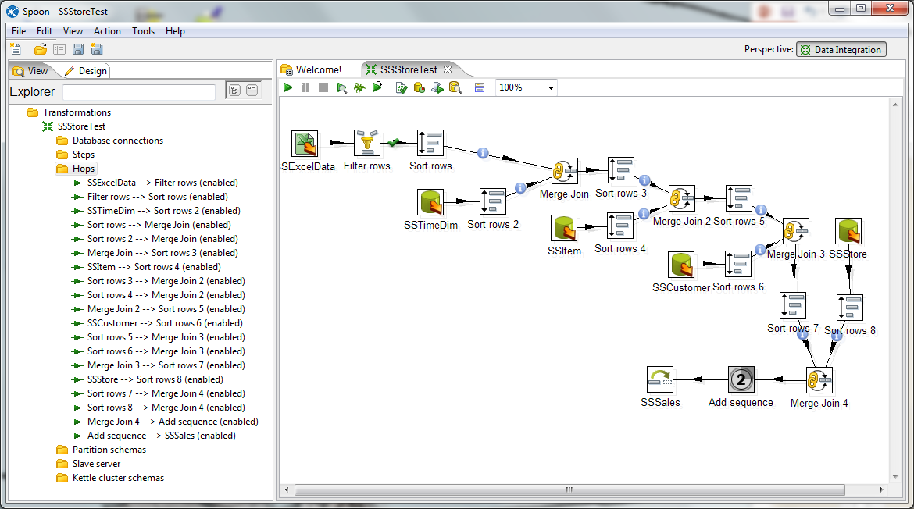
IDE Overview
Notes:
IDE (Integrated Development Environment)
Provides comprehensive features for software development especially visual and graphical tools
Pentaho Data Integration
Graphical code editor for transformations
Execution control including debugging and partial execution
Component browsers for transformation components
Property windows for steps
Wizards for common steps such as database connections

Slide 5
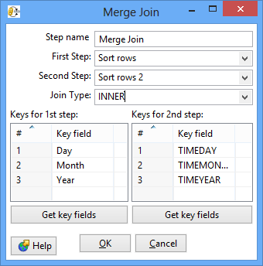
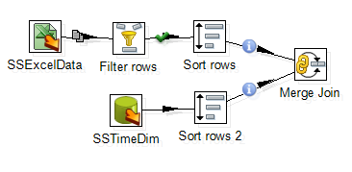
Workflow and Component Specification
Specification Window
Workflow
Notes:
Snapshots from Pentaho Data Integration
Workflow
Data flow among data sources and processes
Graphical specification
Processes
Steps in workflow
Window specification
Optimization
Parallel processing
Specialized algorithms
Data flow specification is too low level for the ordering and algorithms inherent in some specifications such as joins

Slide 6












Workflow Components
Processing
Orchestration
Business intelligence
Database
Data quality
File processing
Notes:
Many transformations
Talend components:
Copyright: Talend icons
Talend components:
Processing such as filter rows and filter columns
Orchestration such as for loop and unite (combine flows)
Business intelligence such as slowly changing dimension algorithm for Oracle and bar chart
Database such as Oracle bulk load and Oracle stored procedure execution
Data quality such as compliance check for columns and interval match
File processing such as file comparison and file copy

Slide 7
Repository
Design objects and relationships
Dependencies
Documentation
Notes:
Design objects and relationships
- Common database for all features
Dependencies
Propagate changes
Change data type
Drop object related to other objects
Documentation
- Export in convenient manner

Slide 8
Job Management
Notes:
Scheduling
Setting a schedule
Repetition
Conditional execution of steps
Execution: start, stop, pause
Monitoring
Logging
Performance alerts and reports

Slide 9

Data Profiling
Descriptive statistics and distribution
Null values
Uniqueness
Pattern matching coverage
Field relationships
Notes:
Benefits:
Improve data quality
Reduce implementation (data loading and refresh) development times
Provide users with improved understanding of data
SQL Server data profiler
Column length
Null value ratio
Column pattern: coverage for values matching regular expressions
Descriptive statistics (min, max, average, median, …) and distribution
Patterns: values matching regular expressions
Uniqueness: distinct value for column or combination of columns
Field relationships: FD coverage, inclusion coverage for potential PK-FK relationships

Slide 10


Change Data Capture
Source Tables
Logs
Publisher
Triggers
Change
Tables
Log extraction processes
Subscriber
Publishing processes
Notes:
Change data can be derived from logs and triggers.
Stored in change tables
Publisher vs subscriber
Publisher (upper left) provides authorization to extract change data
Subscriber (bottom right) uses published change data
Provides control to publisher and convenient access to subscriber
Provides a method to get data into a warehouse also

Slide 11
Summary
Strong trend for integrated development environments
Features for graphical specification, workflows, repository, change data capture, job management, and data profiling
Notes:
Essential for software productivity: support initial loading and refresh processes
Evolution from custom coding to disparate tools to integrated development environments
Common features are graphical specification, transformations, and job management. Data profiling and change data capture are sometimes not provided.
ETL vs. ELT architectures
Both approaches supported
Transform outside DBMS
Transform inside DBMS
Diverse marketplace with DBMS-based and open source tools

